Slide 1
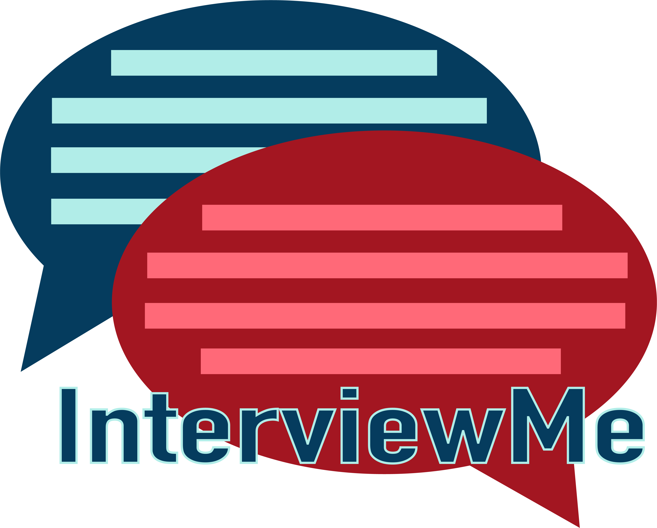

Slide 2

Inspiration
As college students, we realize the challenge an interview can present and wanted to help other students prep for the upcoming interviews and first impressions ahead of them.

Slide 3
What It Does
InterviewMe is both an Alexa Skill and Android app.
It runs through 4 different types of mock interviews both verbally and in text format. In addition to feedback through the full interview, our project also provides tips and tricks and individual practice questions.

Slide 4
How we built it
We used Android Studio and Java to build our application and Node.js and Alexa Skill developer to build our Alexa Skill

Slide 5
What’s next?
iOS app to match,
Recording and playback functionality to Alexa skill,
Add AI for better feedback
Publish to Amazon Store

